Slide 1

Visual Studio 2010 and .NET Framework 4 Training Workshop

Slide 2
Presentation Outline (hidden slide):
Technical Level: 200
Intended Audience: Developers & Architects
Objectives (what do you want the audience to take away):
Understand what is coming with the next release of Visual Studio 2010
Presentation Outline:
Visual Studio as an Editor
Visual Studio as a Platform

Slide 3

What’s New In Visual Studio 2010
Name
Title
Organization
Email

Slide 4
Visual Studio Targets Many…
Complete
Team System
Professional
Feature Set
Express
Minimal
Hobbyist
Audience
Enterprise

Slide 5
Visual Studio Targets Many…
Complete
Team System
Professional
Feature Set
Express
Minimal
Hobbyist
Audience
Enterprise

Slide 6
The Four Pillars of VS2010 “Pro”
Understanding
The Code
Building Web
Applications
Creating Office
Business
Applications
Using The
Power of
C++

Slide 7
New Visual Studio 2010 Features…
Breakpoint Grouping
Parallel Tasks Window
New Look & Feel
Extensible Test Runner
Dynamic Data Tooling
Generate From Usage
WPF-based Editor
Highlight References
Breakpoint Labeling
Click-Once Enhancements for Office
Call Hierarchy
Improved WPF Tooling
Web Deploy
Sharepoint Tooling
Historical Debugging
MVC Tooling
Inline Call Tree
Minidump Debugging
Quick Search
Concurrency Profiler
JQueryIntellisense
Breakpoint Import/Export
Document Map Margin
64-bit Mixed-Mode
Parallel Stacks Window
HTML Snippets
Improved Multi-Monitor
web.config Transformation

Slide 8
The Two Faces of Visual Studio 2010
Visual Studio As An Editor
Visual Studio As A Platform

Slide 9
… As An Editor
An improved focus on…
Writing code,
Understanding code,
Navigating code,
Publishing code

Slide 10
… As A Platform
New Extensible Editor allows editor to
be easily extended to provide a rich
and robust editing experience
Online Visual Studio Gallery
integrated directly into Visual Studio

Slide 11


Welcome to Visual Studio 2010

Slide 12
Some previews of what is to come…

Slide 13
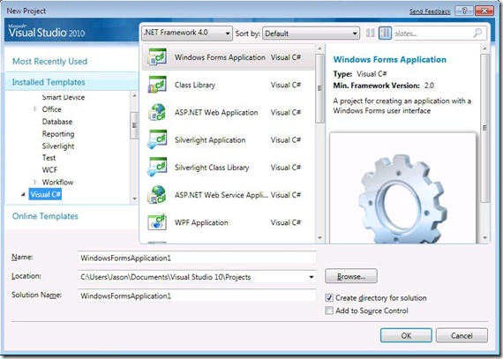

Slide 14
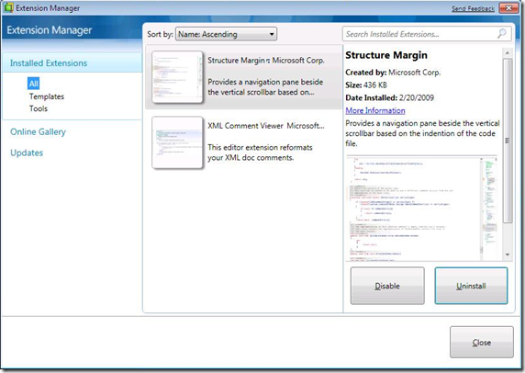

Slide 15
The VS2010 Roadmap
Beta 1, Q2 CY09
Beta 2, H2 CY10
RTM, Before Visual Studio vNextvNext Ships!

